Slide 1

For many psychiatric symptoms, there is a mild form of the same pattern of behavior that serves adaptive purposes in healthy people.
Paget Michael Creelman

Slide 2


Slide 3


Slide 4
Do computational quantities have physiological correlates?
To what degree do aversive vs. neutral stimuli bias behavior?
… could this degree potentially be used as diagnostic tool in computational psychiatry?

Slide 5
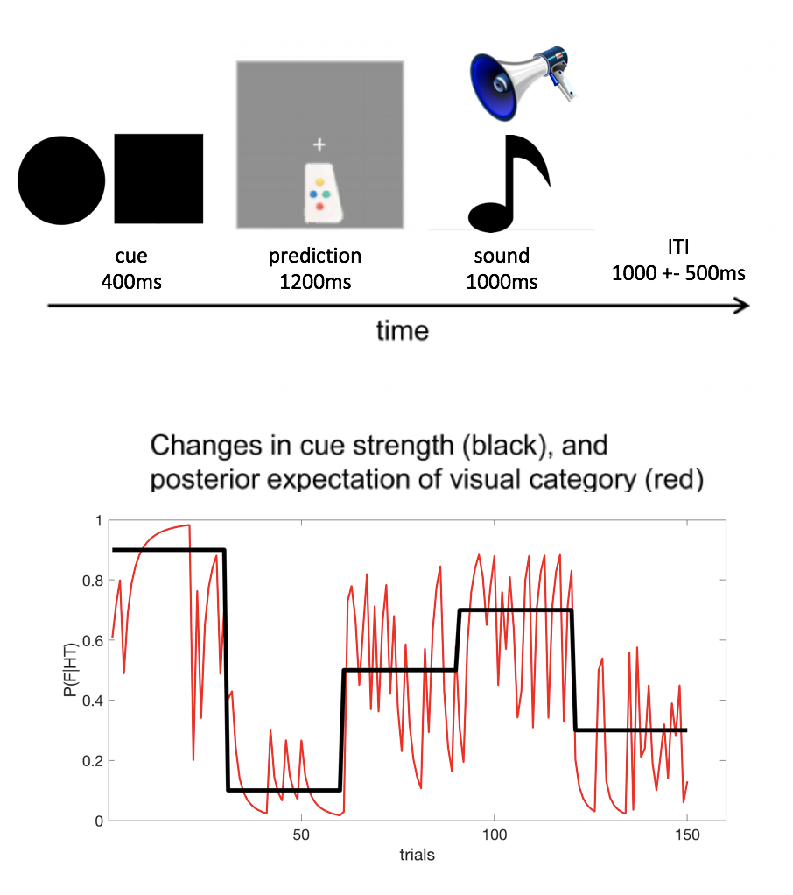
[Iglesias et al. (2013)]
Notes:
Not so loosely inspired….
Recorded N = 16

Slide 6
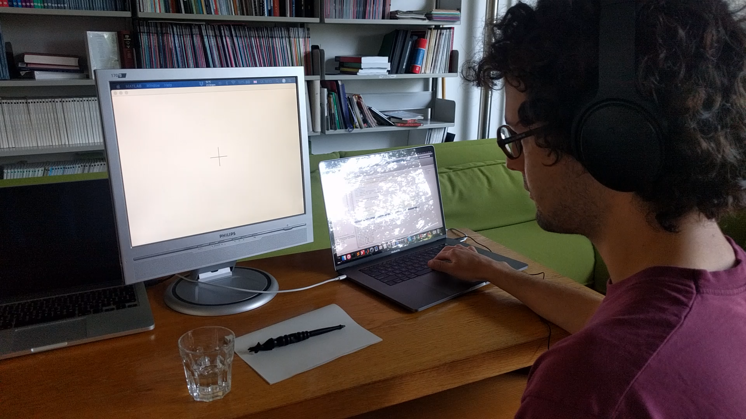
[Iglesias et al. (2013)]
Notes:
Not so loosely inspired….
Recorded N = 16

Slide 7
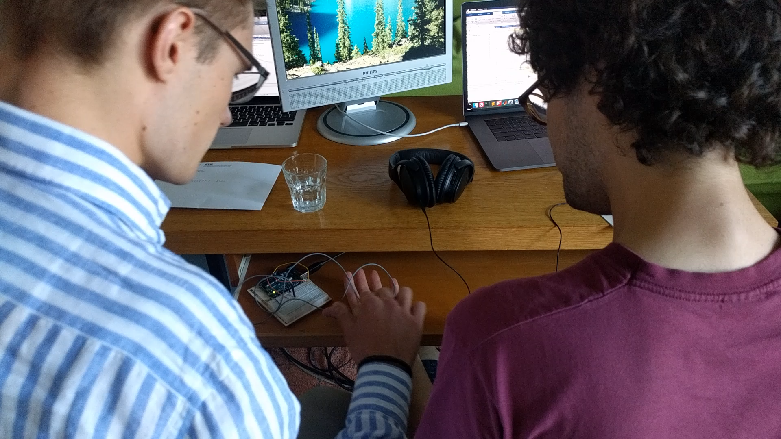

Slide 8
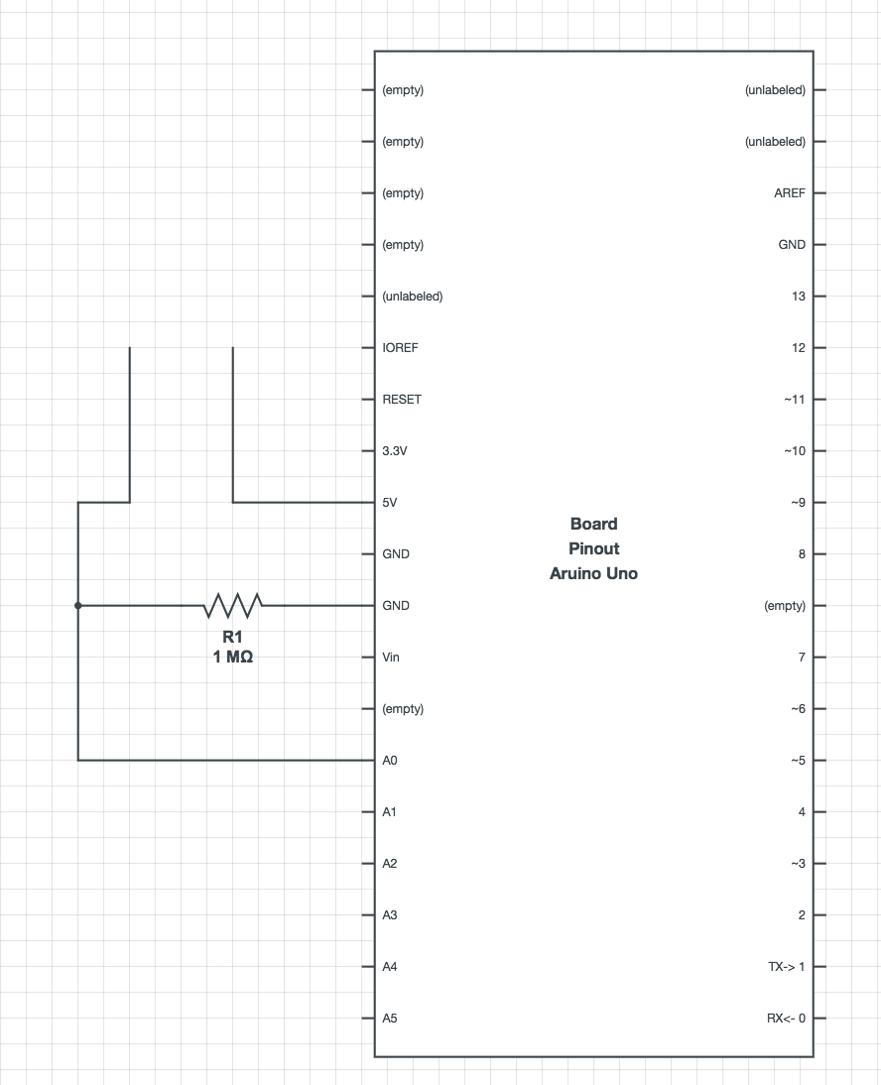
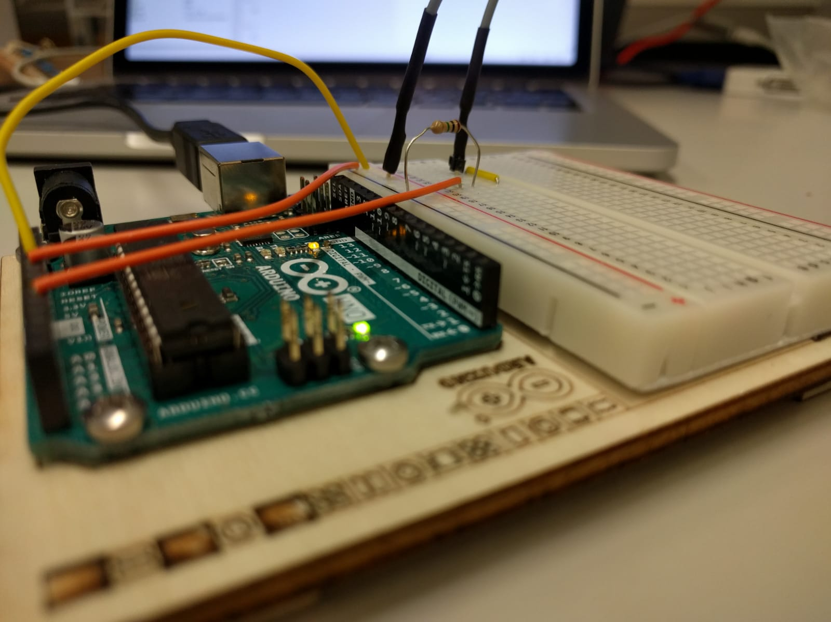
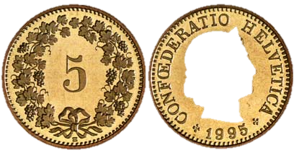
Galvanic Skin Response
Notes:
Handbuilt low quality apperature

Slide 9
Flowchart
Experiment
Subjective measures
Objective measures
Behavioral responses
Galvanic Skin Response (GSR)
Questionnaire
HGF
Alpha Model

Slide 10
Flowchart
Experiment
Subjective measures
Objective measures
Behavioral responses
Galvanic Skin Response (GSR)
Questionnaire
HGF
Alpha Model

Slide 11
Prediction error theorey
Preprocessing in Ledalab
Show mean response to neutral vs aversive sound
Show mean response in wrong vs correct trials
Show canonical GSR response for correct and wrong trials
Correlated with PE traces from the HGFs but didn‘t go above 0.2
Trialwise dot product with canonical functions to determine whether prediction was true or false. → Backtrack beliefs from PE signal in GSR, s.t. an alternative prediction trace is generated that can then be fed into HGF and compared to behavioral model. Still in progress. Asking whether beliefs can be inferred in the absence of behavioral response?
Notes:
Explain GSR prediction error theory

Slide 12
Flowchart
Experiment
Subjective measures
Objective measures
Behavioral responses
Galvanic Skin Response (GSR)
Questionnaire
HGF
Alpha Model

Slide 13
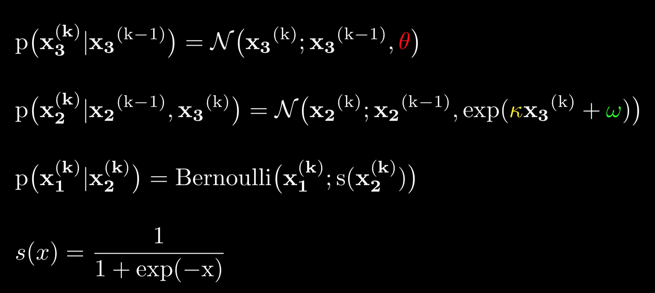
The HGF – A generative model of behavior
variance of volatility
How can we simulate a binary choice?
phasic
tonic
sigmoid

Slide 14
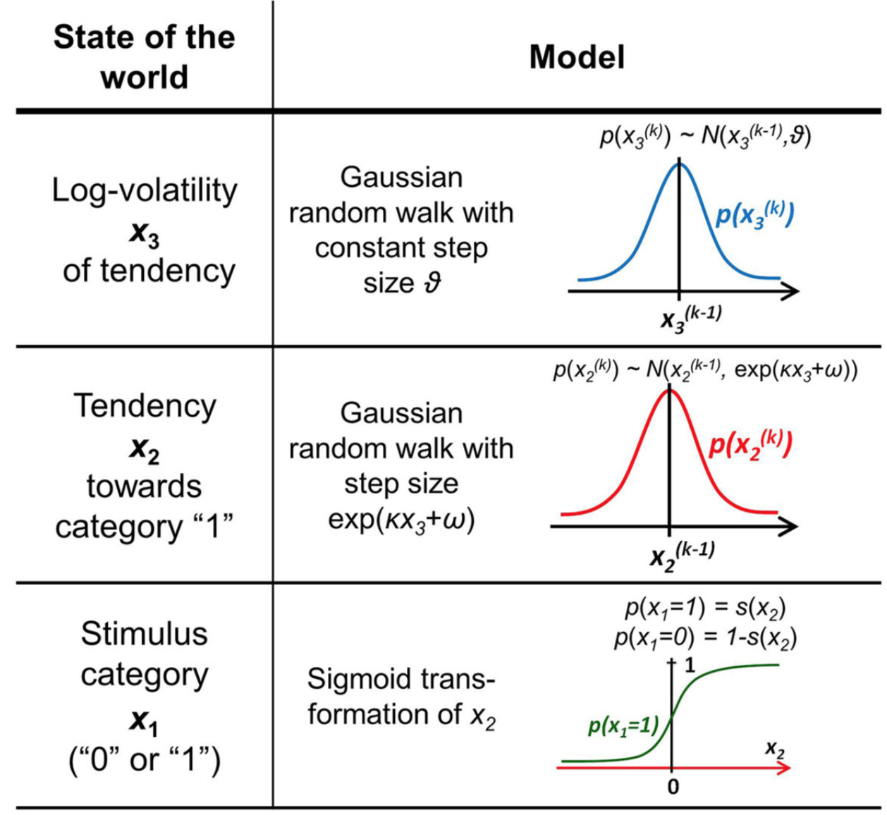
The HGF – A generative model of behavior
STIMULUS CATEGORY and TENDENCY to be read in cue-stimulus-contingency terms:
1 is defined as square → tone or circle → no tone
0 is defined as square → no tone or circle → tone
To what degree do aversive vs. neutral stimuli bias behavior?
Fit HGFs for both neutral and aversive blocks for all subjects and compare parameters.

Slide 15
Flowchart
Experiment
Subjective measures
Objective measures
Behavioral responses
Galvanic Skin Response (GSR)
Questionnaire
HGF
Alpha Model

Slide 16

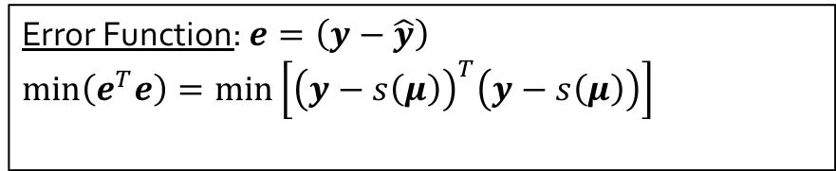
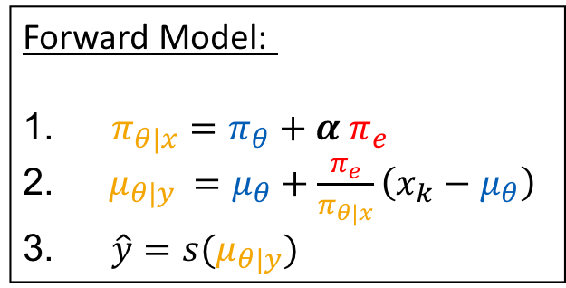
Goal: Find the optimal $α$ for the forward model
Forward Model:
$π_{θ|x}=π_{θ}+α π_{e}$
$μ_{θ|y }=μ_{θ}+\frac{π_{e}}{π_{θ|x}}\left(x_{k}−μ_{θ}\right)$
$\hat{y}=s(μ_{θ|y})$
Error Function: $e=\left(y−\hat{y}\right)$
$\min\left(e^{T}e\right)=\min\left[{\left(y−s\left(μ\right)\right)}^{T}\left(y−s\left(μ\right)\right)\right]$
Notes:
Crucial questions for generative models, how to find the hyperparameter that best explain our data? Here is the forward model again. The third step is optional. Just a very step sigmoid transforming a continuous belief in an almost binary output. This was needed since in our example
Goal is to minimize the sum of squared errors.

Slide 17
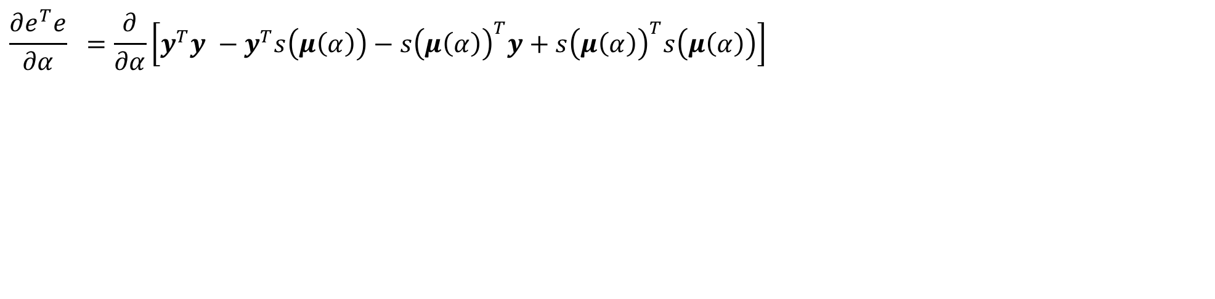
Goal: Find the optimal $α$ for the forward model
Forward Model:
$π_{θ|x}=π_{θ}+α π_{e}$
$μ_{θ|y }=μ_{θ}+\frac{π_{e}}{π_{θ|x}}\left(x_{k}−μ_{θ}\right)$
$\hat{y}=s(μ_{θ|y})$
Error Function: $e=\left(y−\hat{y}\right)$
$\min\left(e^{T}e\right)=\min\left[{\left(y−s\left(μ\right)\right)}^{T}\left(y−s\left(μ\right)\right)\right]$
$$\frac{∂e^{T}e}{∂α} =\frac{∂}{∂α}\left[y^{T}y −y^{T}s\left(μ\left(α\right)\right)−s{\left(μ\left(α\right)\right)}^{T}y+s{\left(μ\left(α\right)\right)}^{T}s\left(μ\left(α\right)\right)\right]$$
Notes:
Minimize quadratic error. Partial derivative: Change in posterior precision, ommitted theta and x for clarity

Slide 18
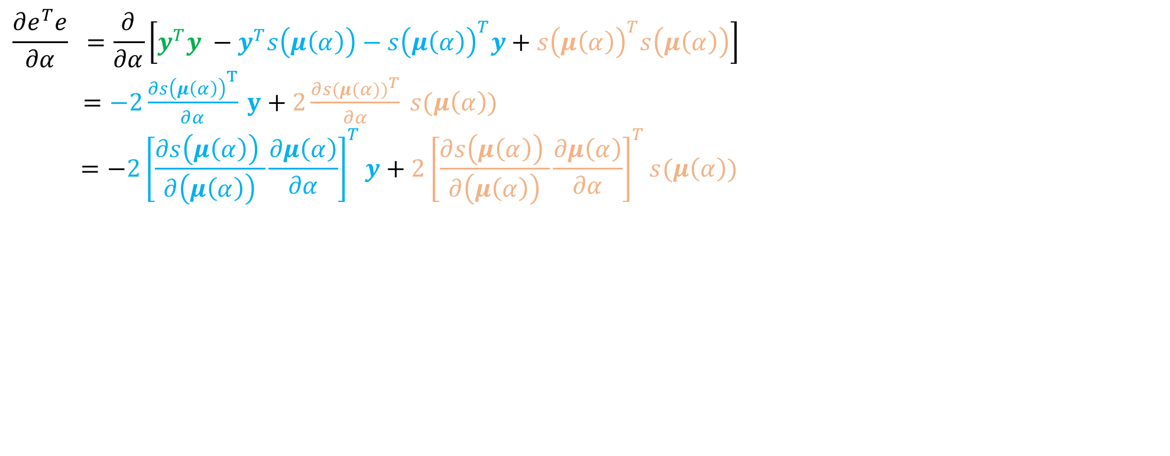
Goal: Find the optimal $α$ for the forward model
Forward Model:
$π_{θ|x}=π_{θ}+α π_{e}$
$μ_{θ|y }=μ_{θ}+\frac{π_{e}}{π_{θ|x}}\left(x_{k}−μ_{θ}\right)$
$\hat{y}=s(μ_{θ|y})$
Error Function: $e=\left(y−\hat{y}\right)$
$\min\left(e^{T}e\right)=\min\left[{\left(y−s\left(μ\right)\right)}^{T}\left(y−s\left(μ\right)\right)\right]$
$$\frac{∂e^{T}e}{∂α} =\frac{∂}{∂α}\left[y^{T}y −y^{T}s\left(μ\left(α\right)\right)−s{\left(μ\left(α\right)\right)}^{T}y+s{\left(μ\left(α\right)\right)}^{T}s\left(μ\left(α\right)\right)\right]$$
$=−2\frac{∂s{\left(μ\left(α\right)\right)}^{T}}{∂α} y+2\frac{∂s({μ(α))}^{T}}{∂α} s(μ\left(α\right))$
$$=−2{\left[\frac{∂s{\left(μ\left(α\right)\right)}^{ }}{∂\left(μ\left(α\right)\right)}\frac{∂μ\left(α\right)}{∂α}\right]}^{T}y+2{\left[\frac{∂s{\left(μ\left(α\right)\right)}^{ }}{∂\left(μ\left(α\right)\right)}\frac{∂μ\left(α\right)}{∂α}\right]}^{T}s(μ\left(α\right))$$
Notes:
Looks quite tedious. Unfortunately, the mus are vectors that are updated iteratively. Does this beast even have an analytical solution? With our vague math skills we were unable tofind a closed form expression and thus decided to compute the partial derivatives iteratively as time progresses. We know that‘s not pretty, if you have any thoughts on this we‘d be happy to hear it.

Slide 19
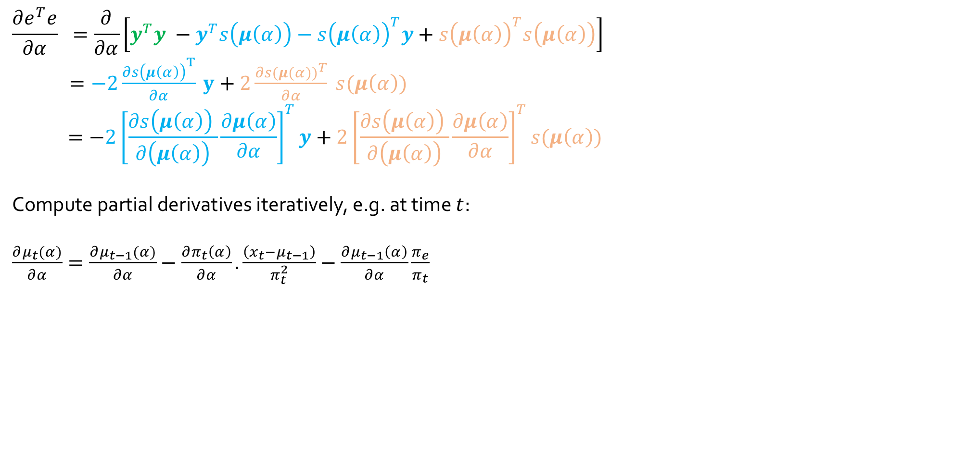
Goal: Find the optimal $α$ for the forward model
Forward Model:
$π_{θ|x}=π_{θ}+α π_{e}$
$μ_{θ|y }=μ_{θ}+\frac{π_{e}}{π_{θ|x}}\left(x_{k}−μ_{θ}\right)$
$\hat{y}=s(μ_{θ|y})$
Error Function: $e=\left(y−\hat{y}\right)$
$\min\left(e^{T}e\right)=\min\left[{\left(y−s\left(μ\right)\right)}^{T}\left(y−s\left(μ\right)\right)\right]$
$$\frac{∂e^{T}e}{∂α} =\frac{∂}{∂α}\left[y^{T}y −y^{T}s\left(μ\left(α\right)\right)−s{\left(μ\left(α\right)\right)}^{T}y+s{\left(μ\left(α\right)\right)}^{T}s\left(μ\left(α\right)\right)\right]$$
$=−2\frac{∂s{\left(μ\left(α\right)\right)}^{T}}{∂α} y+2\frac{∂s({μ(α))}^{T}}{∂α} s(μ\left(α\right))$
$$=−2{\left[\frac{∂s{\left(μ\left(α\right)\right)}^{ }}{∂\left(μ\left(α\right)\right)}\frac{∂μ\left(α\right)}{∂α}\right]}^{T}y+2{\left[\frac{∂s{\left(μ\left(α\right)\right)}^{ }}{∂\left(μ\left(α\right)\right)}\frac{∂μ\left(α\right)}{∂α}\right]}^{T}s(μ\left(α\right))$$
Compute partial derivatives iteratively, e.g. at time $t$:
$\frac{∂μ_{t}(α)}{∂α}=\frac{∂μ_{t−1}(α)}{∂α}−\frac{∂π_{t}\left(α\right)}{∂α}. \frac{\left(x_{t}−μ_{t−1}\right)}{π_{t}^{2}}−\frac{∂μ_{t−1}\left(α\right)}{∂α}\frac{π_{e}}{π_{t}}$
Notes:
Apply chain rule

Slide 20
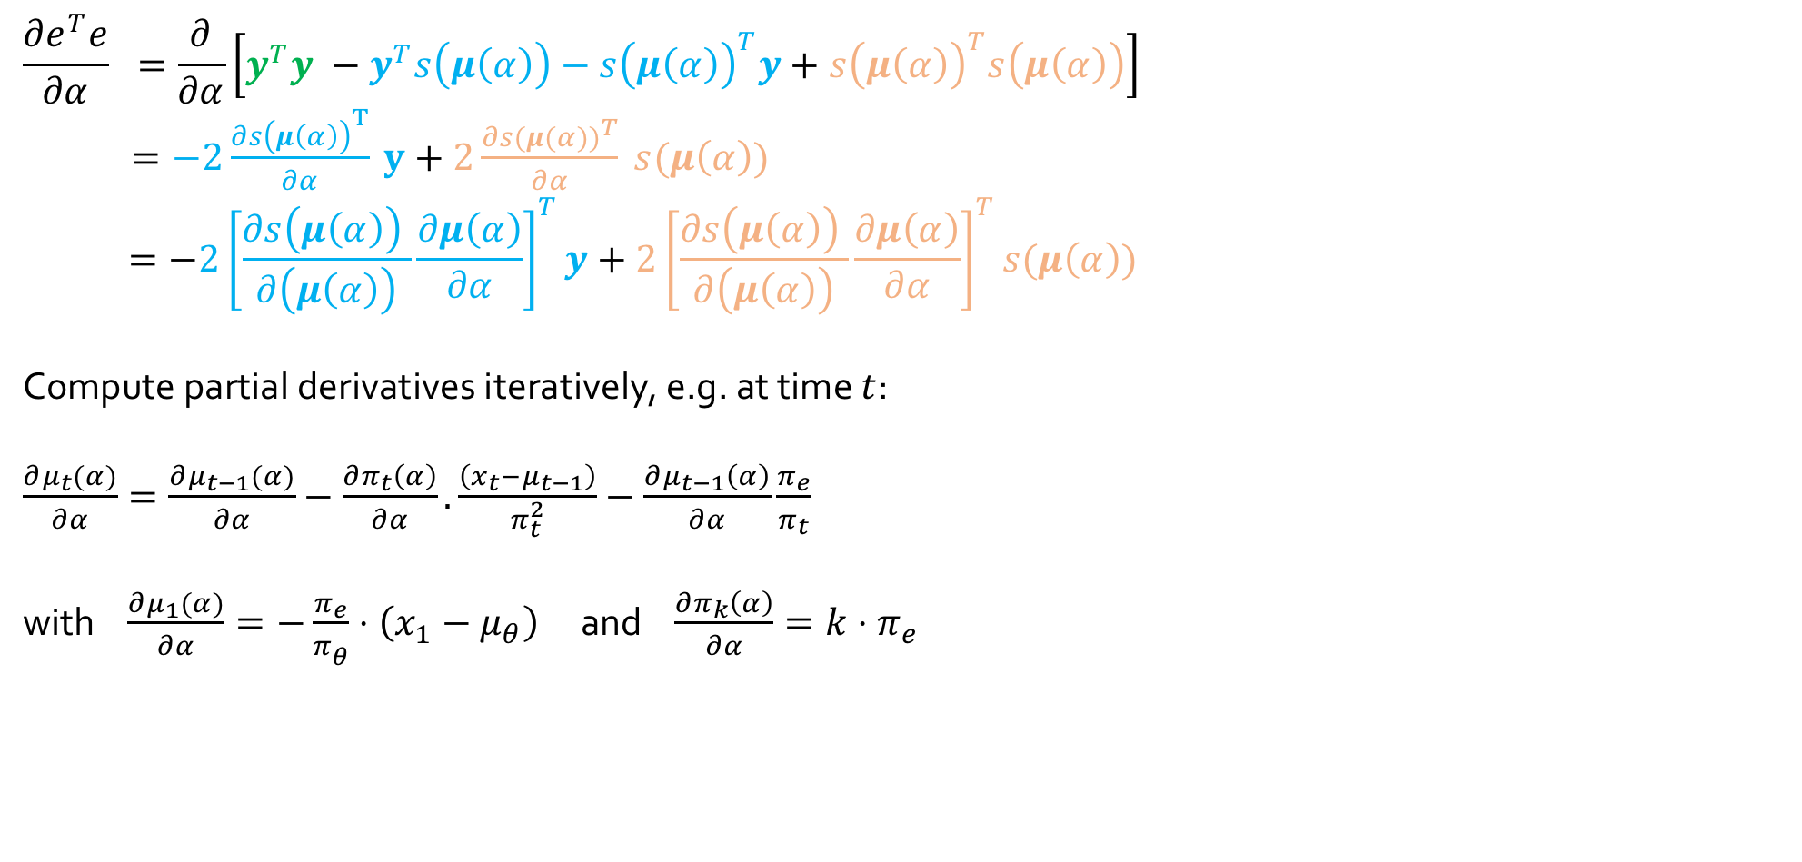
Goal: Find the optimal $α$ for the forward model
Forward Model:
$π_{θ|x}=π_{θ}+α π_{e}$
$μ_{θ|y }=μ_{θ}+\frac{π_{e}}{π_{θ|x}}\left(x_{k}−μ_{θ}\right)$
$\hat{y}=s(μ_{θ|y})$
Error Function: $e=\left(y−\hat{y}\right)$
$\min\left(e^{T}e\right)=\min\left[{\left(y−s\left(μ\right)\right)}^{T}\left(y−s\left(μ\right)\right)\right]$
$$\frac{∂e^{T}e}{∂α} =\frac{∂}{∂α}\left[y^{T}y −y^{T}s\left(μ\left(α\right)\right)−s{\left(μ\left(α\right)\right)}^{T}y+s{\left(μ\left(α\right)\right)}^{T}s\left(μ\left(α\right)\right)\right]$$
$=−2\frac{∂s{\left(μ\left(α\right)\right)}^{T}}{∂α} y+2\frac{∂s({μ(α))}^{T}}{∂α} s(μ\left(α\right))$
$$=−2{\left[\frac{∂s{\left(μ\left(α\right)\right)}^{ }}{∂\left(μ\left(α\right)\right)}\frac{∂μ\left(α\right)}{∂α}\right]}^{T}y+2{\left[\frac{∂s{\left(μ\left(α\right)\right)}^{ }}{∂\left(μ\left(α\right)\right)}\frac{∂μ\left(α\right)}{∂α}\right]}^{T}s(μ\left(α\right))$$
Compute partial derivatives iteratively, e.g. at time $t$:
$\frac{∂μ_{t}(α)}{∂α}=\frac{∂μ_{t−1}(α)}{∂α}−\frac{∂π_{t}\left(α\right)}{∂α}. \frac{\left(x_{t}−μ_{t−1}\right)}{π_{t}^{2}}−\frac{∂μ_{t−1}\left(α\right)}{∂α}\frac{π_{e}}{π_{t}}$
with $\frac{∂μ_{1}(α)}{∂α}=−\frac{π_{e}}{π_{θ}^{ }}⋅\left(x_{1}−μ_{θ}\right)$ and $\frac{∂π_{k}\left(α\right)}{∂α}=k⋅π_{e}$
Notes:
Humble, not good enough in math to find closed form analytical solution. Problematically the error surface may not be convex, so that we cannot simply set to 0.
Therefore we compute the partial derivatives iteratively starting at t=0.
Result: Precision goes up linearly, at kth time step it has improved by k times llh precision wrt first timestep
Change in belief is nothing but a precision weighted prediction error.

Slide 21
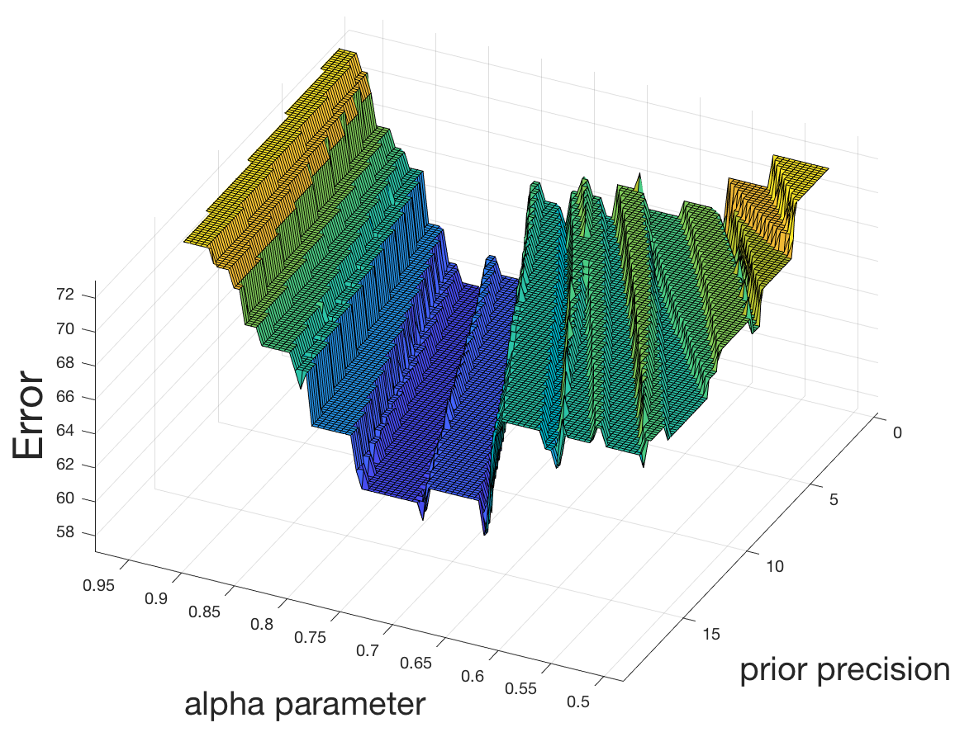

Goal: Find the optimal $α$ for the forward model
Forward Model:
$π_{θ|x}=π_{θ}+α π_{e}$
$μ_{θ|y }=μ_{θ}+\frac{π_{e}}{π_{θ|x}}\left(x_{k}−μ_{θ}\right)$
$\hat{y}=s(μ_{θ|y})$
Error Function: $e=\left(y−\hat{y}\right)$
$\min\left(e^{T}e\right)=\min\left[{\left(y−s\left(μ\right)\right)}^{T}\left(y−s\left(μ\right)\right)\right]$
$$\frac{∂e^{T}e}{∂α} =\frac{∂}{∂α}\left[y^{T}y −y^{T}s\left(μ\left(α\right)\right)−s{\left(μ\left(α\right)\right)}^{T}y+s{\left(μ\left(α\right)\right)}^{T}s\left(μ\left(α\right)\right)\right]$$
$=−2\frac{∂s{\left(μ\left(α\right)\right)}^{T}}{∂α} y+2\frac{∂s({μ(α))}^{T}}{∂α} s(μ\left(α\right))$
$$=−2{\left[\frac{∂s{\left(μ\left(α\right)\right)}^{ }}{∂\left(μ\left(α\right)\right)}\frac{∂μ\left(α\right)}{∂α}\right]}^{T}y+2{\left[\frac{∂s{\left(μ\left(α\right)\right)}^{ }}{∂\left(μ\left(α\right)\right)}\frac{∂μ\left(α\right)}{∂α}\right]}^{T}s(μ\left(α\right))$$
Compute partial derivatives iteratively, e.g. at time $t$:
$\frac{∂μ_{t}(α)}{∂α}=\frac{∂μ_{t−1}(α)}{∂α}−\frac{∂π_{t}\left(α\right)}{∂α}. \frac{π_{e}\left(x_{t}−μ_{t−1}\right)}{π_{t}^{2}}−\frac{∂μ_{t−1}\left(α\right)}{∂α}\frac{π_{e}}{π_{t}}$
with $\frac{∂μ_{1}(α)}{∂α}=−\frac{π_{e}^{2}}{π_{θ}^{2}}⋅\left(x_{1}−μ_{θ}\right)$ and $\frac{∂π_{k}\left(α\right)}{∂α}=k⋅π_{e}$
precision-weighted prediction error
Notes:
Of course, this method comes with all the drawbacks that local optimization techniques have w.r.t. non-convex error surfaces.
Here is an example of one of one of our participants we fitted. Clearly alpha plays the dominant role for the fit compared to the prior precision.

Slide 22
References
By Paget Michael Creelman - Own work, CC BY-SA 4.0, https://commons.wikimedia.org/w/index.php?curid=67346556
Iglesias, Sandra, et al. "Hierarchical prediction errors in midbrain and basal forebrain during sensory learning." Neuron 80.2 (2013): 519-530.

